Slide 1

Compositional Reasoning of P programs
P Language
Ankush Desai, UC Berkeley
Shaz Qadeer, Microsoft Research

Slide 2
Recap
P program is a collection of state machines.
P provides primitives for modeling non-determinism and performing “unit” testing.
P compiler generates both code for systematic testing and C/C++ code for execution.
P systematic testing engine is able to reproduce hard to find Heisenbugs in asynchronous message passing programs.

Slide 3
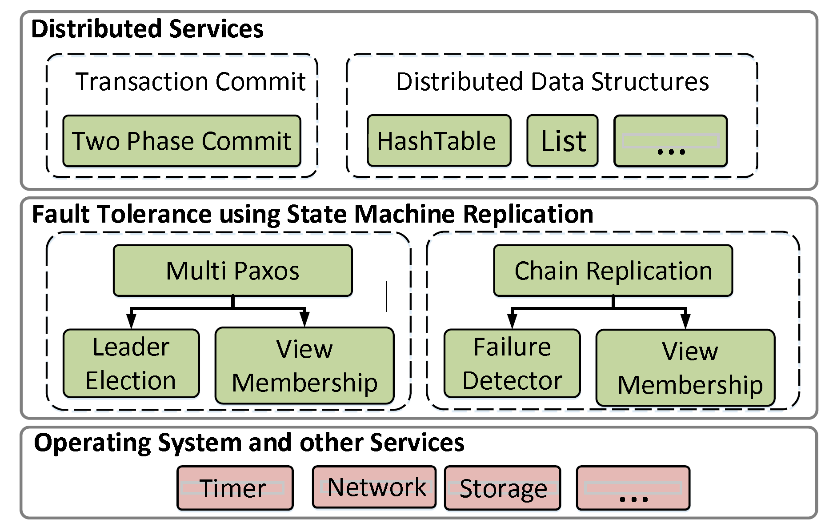
Fault-Tolerant Distributed System
Transaction commit service using Two Phase Commit protocol.
Software stack of a fault-tolerant distributed application
State machine replication is a general method for implementing a fault-tolerant service by replicating logs.

Slide 4
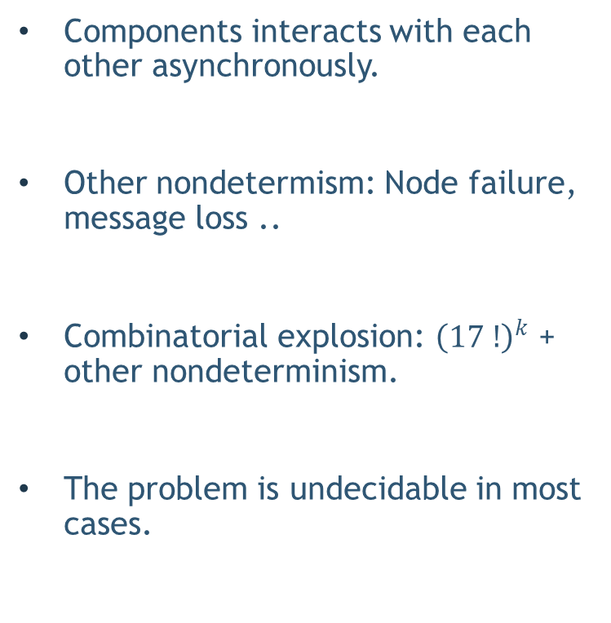
Testing Distributed Systems is Challenging
Components interacts with each other asynchronously.
Other nondetermism: Node failure, message loss ..
Combinatorial explosion: ${\left(17 !\right)}^{k}$ + other nondeterminism.
The problem is undecidable in most cases.
1 fault tolerant system
4
3
3
3
3
$${worst case total executions :\left(17 !\right)}^{k}$$

Slide 5
Testing Distributed Systems is Challenging
Exhaustive and random search techniques do not scale.
Inadequate test coverage.
Symbolic execution based approaches also face the path explosion problem.
In practice, bugs are generally found in production or after deployment !

Slide 6
Scalable Testing of Distributed Systems
Problem:
Monolithic testing does not scale.
No re-use of the systematic testing effort.

Slide 7
Solution: Divide and Conquer
Two fold:
Test-amplification via abstractions: Test each component in isolation.
Module system based on theory compositional refinement: Test “whole-system” properties by testing each component in isolation.

Slide 8
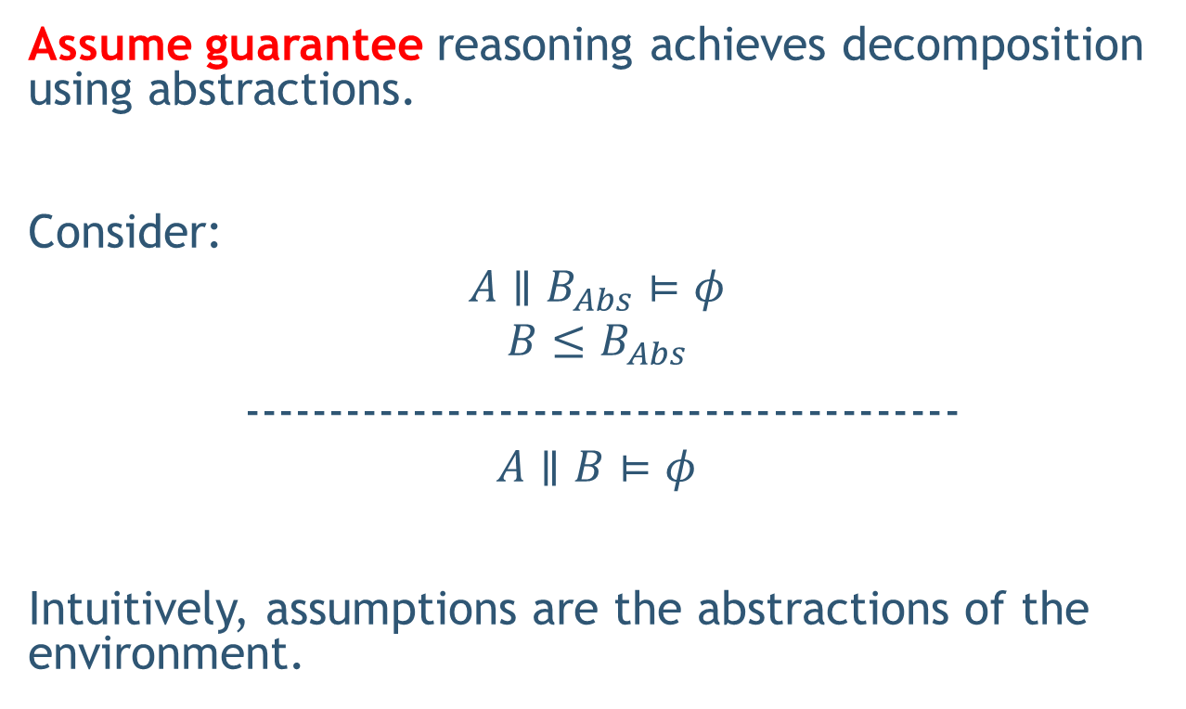
Test Amplification via Abstraction
Assume guarantee reasoning achieves decomposition using abstractions.
Consider:
$$A∥B_{Abs}⊨φ$$
$$B≤B_{Abs}$$
------------------------------------------
$$A∥B⊨φ$$
Intuitively, assumptions are the abstractions of the environment.

Slide 9
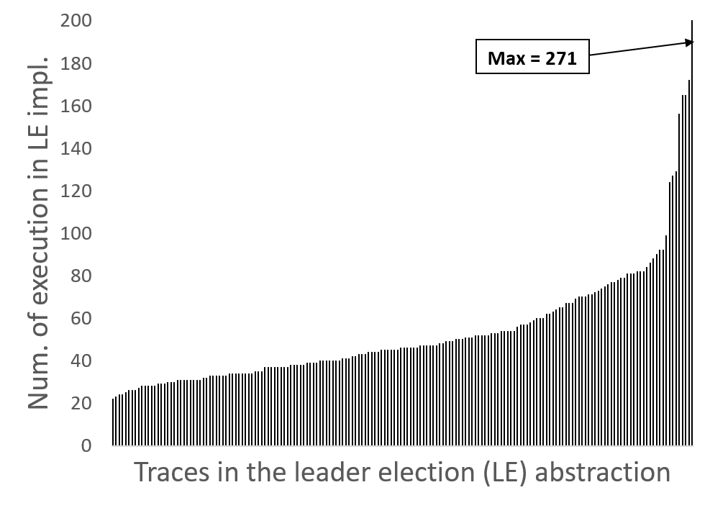
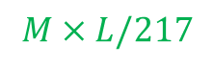

Test-Coverage Amplification
$$MultiPaxos∥ LeaderElection≤Linearizability$$
$$M×L$$
$$MultiPaxos∥ LeaderElectionAbs≤Linearizability$$
$$M×L/217$$
N = 3, K = 50
Almost linear scale up in test coverage

Slide 10
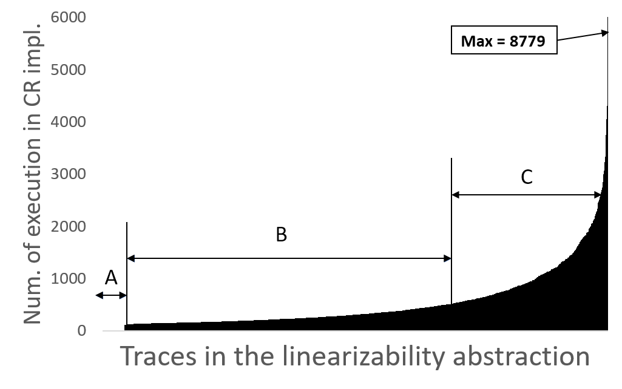
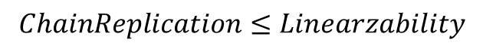
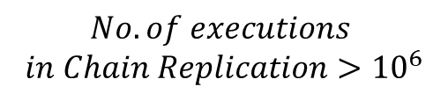
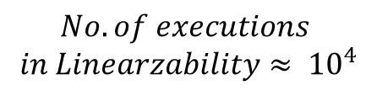
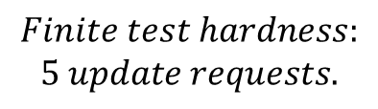
Test-Coverage Amplification
$$ChainReplication≤Linearzability$$
$$Finite test hardness:$$
$$5 update requests.$$
$$No. of executions$$
$$in Linearzability≈ {10}^{4}$$
$$No. of executions$$
$$in Chain Replication>{10}^{6}$$
Hard to find executions or false positives,
Low probability executions, (C) High probability executions

Slide 11
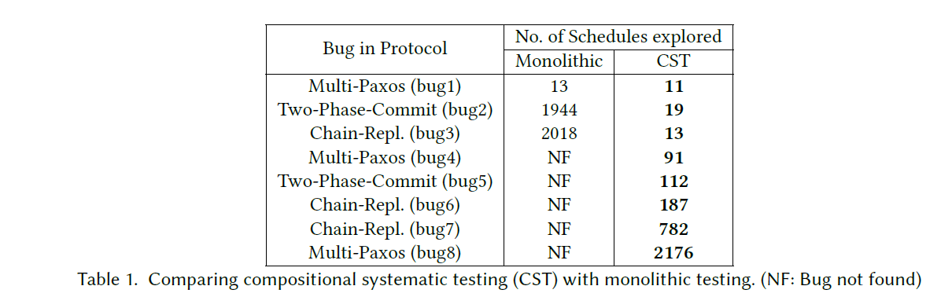
Compositional vs Monolithic

Slide 12
Solution: Divide and Conquer
Two fold:
Test-amplification via abstractions: Test each component in isolation.
Module system based on theory compositional refinement: Test “whole-system” properties by testing each component in isolation.

Slide 13
Assume Guarantee Reasoning
There are three technical mechanisms required for introducing assume-guarantee reasoning into a programming framework:
A notion of a module that can be composed with other modules.
The ability to describe a module at multiple levels of abstraction and check that a concrete description refines an abstract description.
The capability to seamlessly substitute, in the environment of a module, any concrete module with its abstraction.

Slide 14
Module
A module in P is a collection of state machines.
module Client = { ClientMachine, Timer };
module Server = { ServerMachine };

Slide 15
Substitution
A key feature required for compositional reasoning is substitution, the ability to seamlessly bind the creation statement:
{ ..
new IServer()
..}
to ServerImpl when testing server implementation and to ServerAbs when testing its environment.

Slide 16
Revisit PingPong

Slide 17
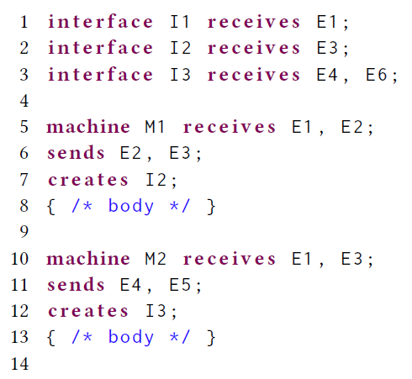
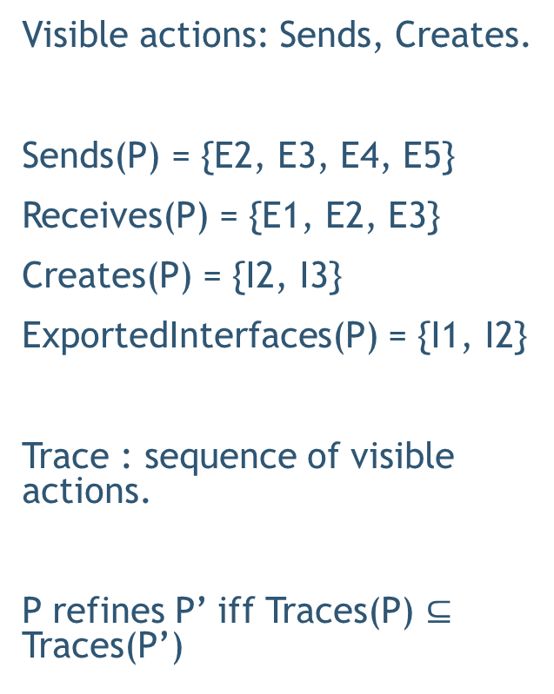
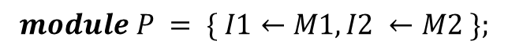
Traces and Refinement
Visible actions: Sends, Creates.
Sends(P) = {E2, E3, E4, E5}
Receives(P) = {E1, E2, E3}
Creates(P) = {I2, I3}
ExportedInterfaces(P) = {I1, I2}
Trace : sequence of visible actions.
P refines P’ iff Traces(P) $⊆$ Traces(P’)
$$module P = \{ I1←M1, I2 ←M2 \};$$

Slide 18
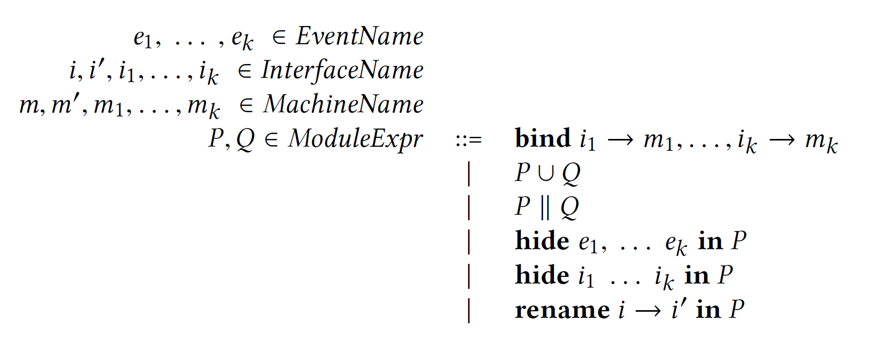
Module Constructors

Slide 19
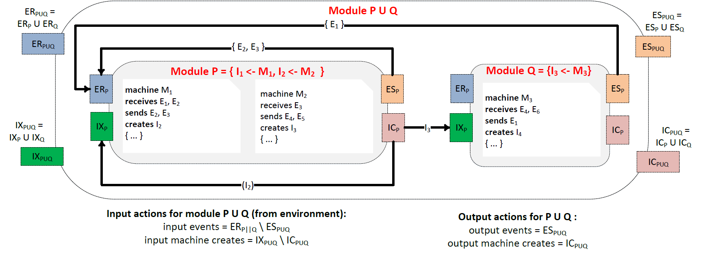
Union
$P∪Q$: a union of the functionalities of P and Q.

Slide 20
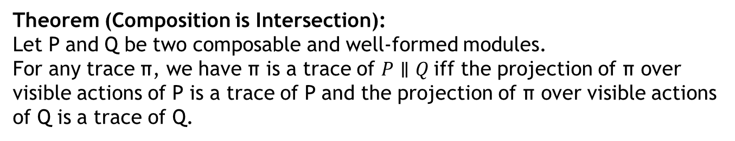
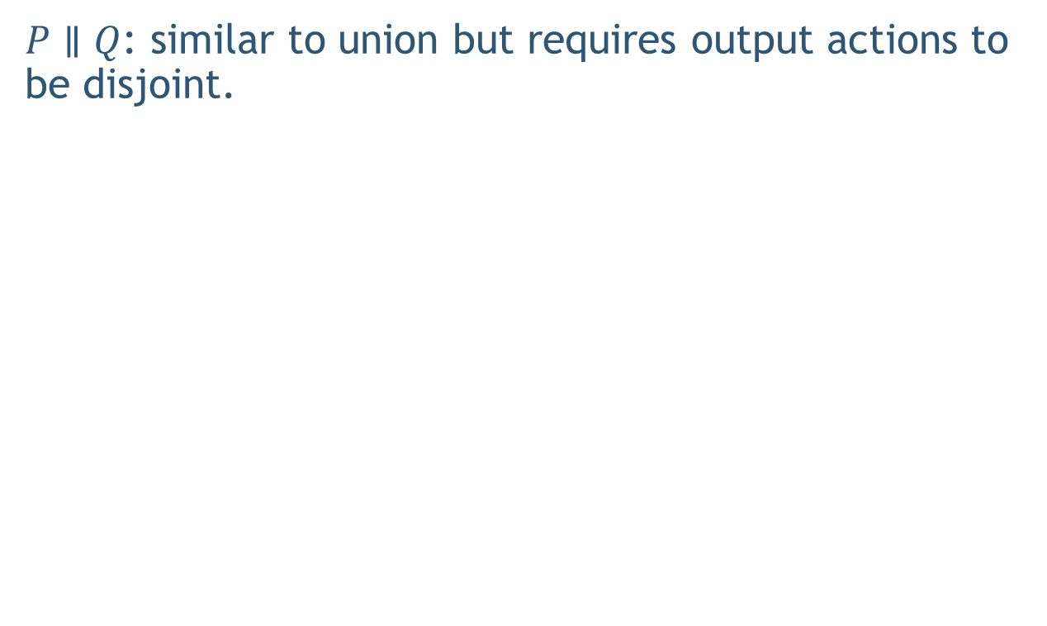
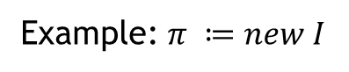
Composition
$P∥Q$: similar to union but requires output actions to be disjoint.
Theorem (Composition is Intersection):
Let P and Q be two composable and well-formed modules.
For any trace π, we have π is a trace of $P∥Q$iff the projection of π over visible actions of P is a trace of P and the projection of π over visible actions of Q is a trace of Q.
Example: $π ≔new I$

Slide 21
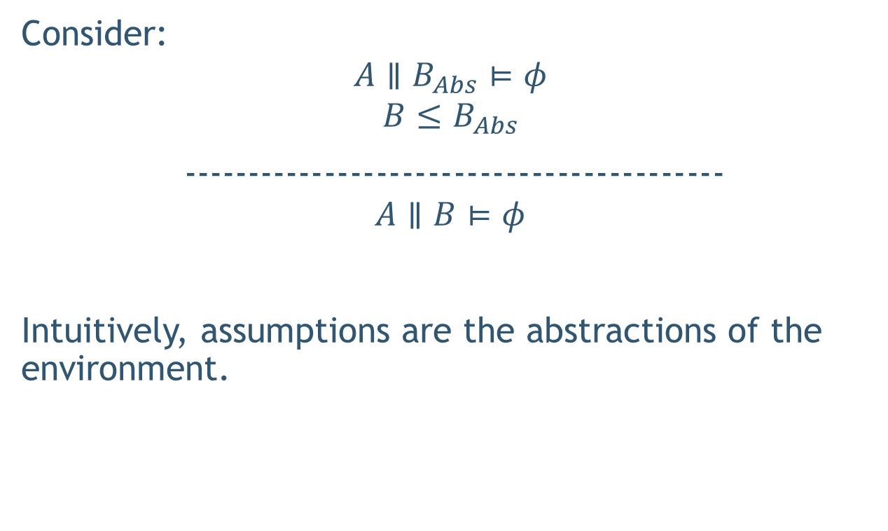
Assume Guarantee (AG) Reasoning
Consider:
$$A∥B_{Abs}⊨φ$$
$$B≤B_{Abs}$$
------------------------------------------
$$A∥B⊨φ$$
Intuitively, assumptions are the abstractions of the environment.

Slide 22
Example
Compositional Reasoning and Refinement Checking

Slide 23
Compositional Reasoning of Distributed Systems
Decompose using AG principle into following simpler checks:
Layer 0
Layer 1
Layer 1
$$MultiPaxos∥ LeaderElection∥ .. ≤ MultiPaxosSMR$$
Layer 2

Slide 24
Why do refinement ?
Refinement helps ensure that we are not missing behaviors during testing.
Found multiple cases where our abstraction was unsound and could have led to failure in composed system.

Slide 25
Hierarchical Reasoning
https://github.com/p-org/P/blob/master/Src/Samples/FaultTolerantDistributedSystems/ChainReplication/Test/TestScript.p

Slide 26
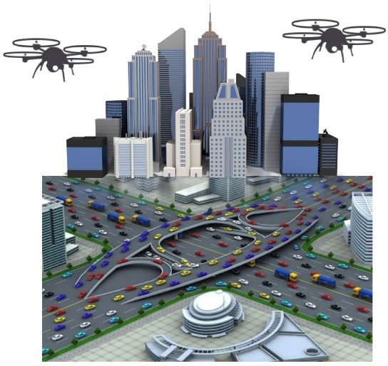
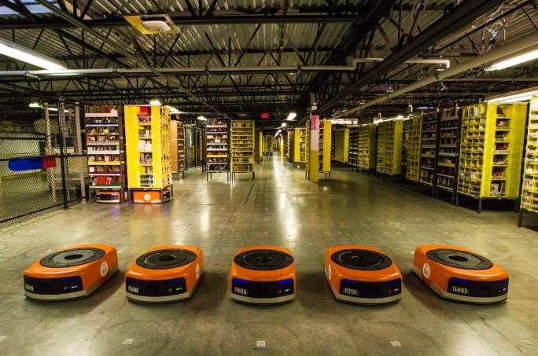
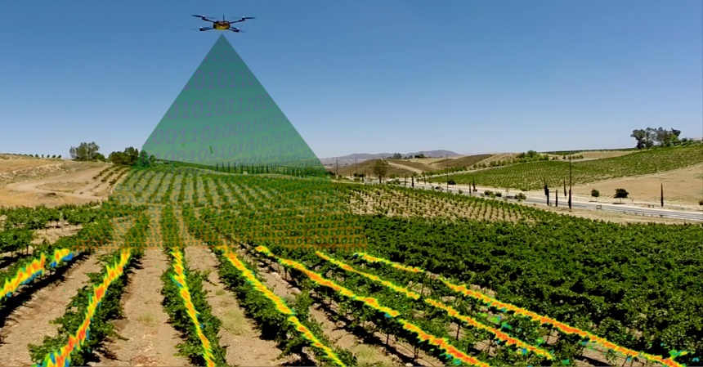
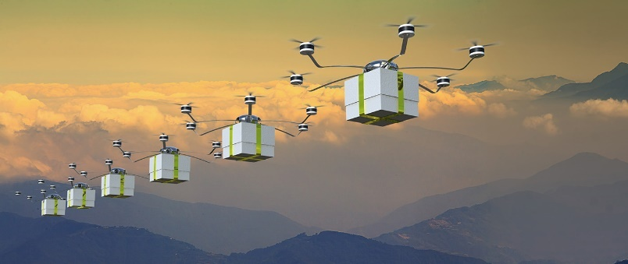
Autonomous Mobile Robotics
Warehouse
A major challenge in autonomous mobile robotics is programming robots with formal guarantees and high assurance of correct operation.
Surveillance
Delivery Systems
Agriculture
Notes:
Recent advances in autonomous robots collaborating to accomplish complex missions have been brought back exciting times for robotics research.
They have been applied to build real world systems and found applications in areas like

Slide 27
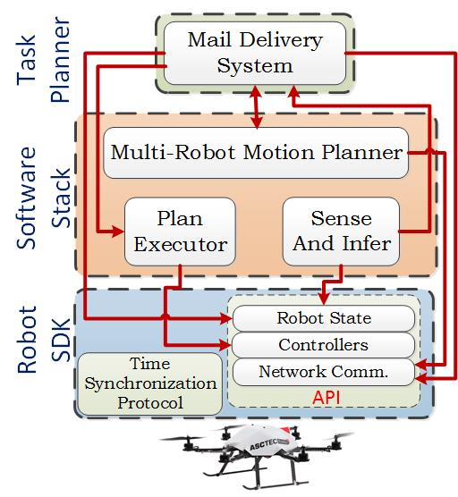
Robotic Software

Slide 28
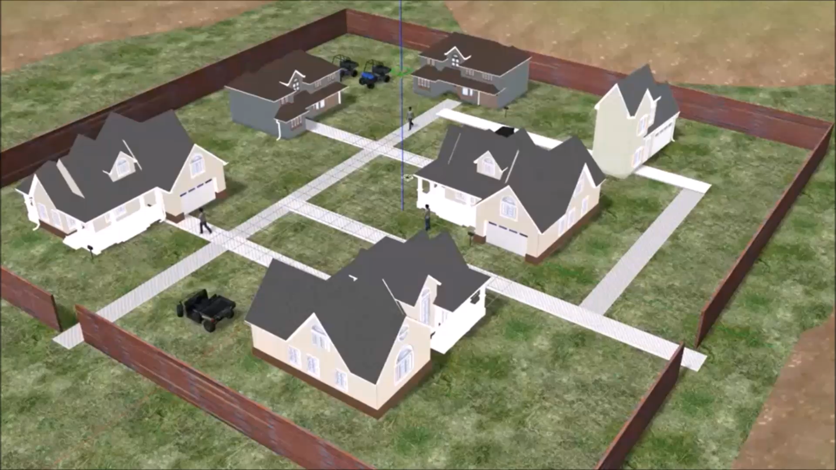
Demo Video

Slide 29
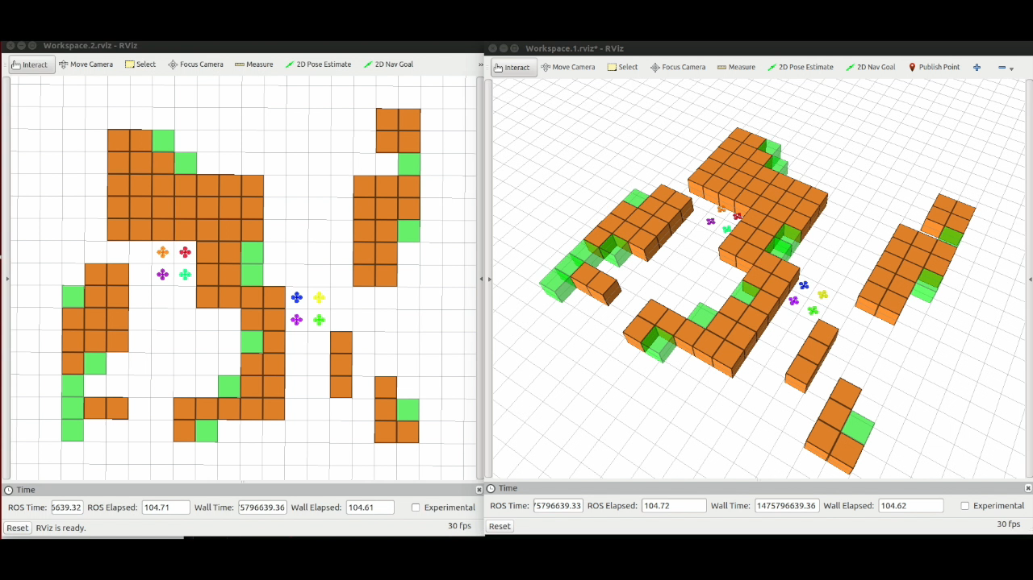
Demo Video

Slide 30
Thank You
DRONA is available on GitHub.
http://drona-org.github.io/Drona/

